Slide 1
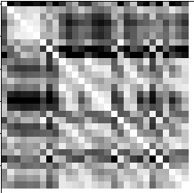
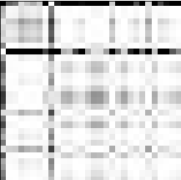
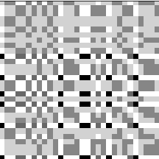
Recurrence Plot
Gramian Angular Field
Markov Transition Field

Slide 2
Layers:
Input
Convolutional
Avg. Pooling
Fully Connected
Output
3 channels:
RP, GAF, MTF
32 x 3
3 x 3 x 3 Filters
+ Leaky ReLU
64 x 3
3 x 3 x 3 Filters
+ Leaky ReLU
64 x 3 3 x 2 x 2 Filters + Leaky ReLU
+ Leaky ReLU
+ Softmax
3 x 30 x 30
3 x 30 x 30 x 32
3 x 30 x 30 x 64
3 x 15 x 15 x 64
128
3
Batch Norm.
Dropout
Batch Norm.
Dropout
Batch Norm.
Dropout

Slide 3
AVERAGE Pooling
Fully Connected
Input
Convolutional
Output
3 channels:
RP, GAF, MTF
32 x 3
3 x 3 x 3 Filters
+ Leaky ReLU
64 x 3
3 x 3 x 3 Filters
+ Leaky ReLU
64 x 3 3 x 2 x 2 Filters + Leaky ReLU
+ Leaky ReLU
+ Softmax
3 x 30 x 30
3 x 30 x 30 x 32
3 x 30 x 30 x 64
3 x 15 x 15 x 64
128
3
Batch Norm.
Dropout
Batch Norm.
Dropout
Batch Norm.
Dropout

